Slide 1
IFB295 – IT Project Management
Week 11 – Tutorial No. 10
PRINCE2
6th – 9th October 2020
Tutor: <insert name here>
Notes:
1
1
1

Slide 2

Recap of Week 10 Tutorial
Product Breakdown Structure
Work Breakdown Structure
Questions / Queries regarding Assessment 2
Group Activity

Slide 3
Today’s Learning Outcome
Gantt Chart
Project Resource Management Technique
Questions / Queries regarding Assessment 3
Team Activity – Mika Music School

Slide 4
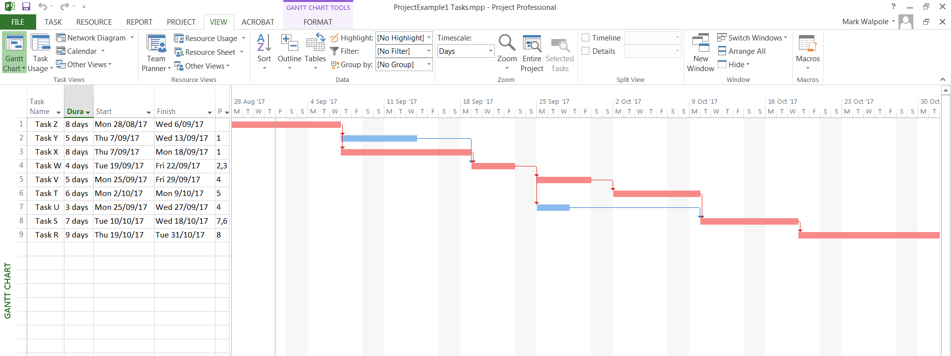
Scheduling with Gantt Charts
Establish a timeline. MS Project
Left hand side is the tabular form of the WBS.
Right hand side is the Gantt Chart of the Project.
(Critical Path (CP) tasks in red, Non-critical path tasks in blue).
4

Slide 5
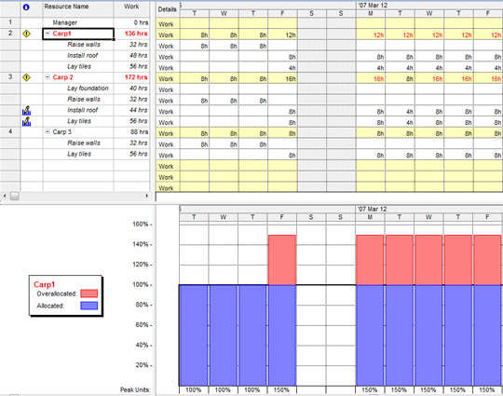
Resources and Constraints
Example:
Resource
Usage
Table
Resource
Chart
5

Slide 6
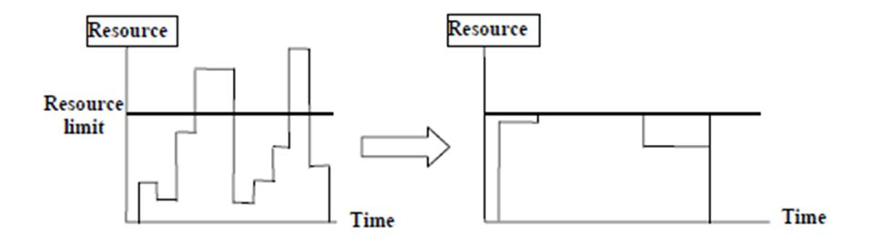
Resource Levelling
Benefits
More constant, uniform and consistent use of resources:
requires less management.
enables just-in-time inventory policy for expensive resources.
results in fewer problems for project personnel and accounting department.
improves morale.
6

Slide 7
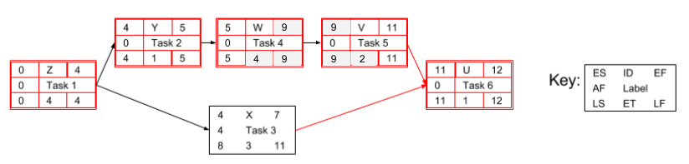
Example: Project with 6 tasks (U to Z)
Use a network diagram to determine the Critical Path
ID | Task | Pred. | Expected Time (ET) | ES | EF | LS | LF | Slack | Resource (R₁)
1 | Z |  | 4 | 0 | 4 | 0 | 4 | 0 | 6
2 | Y | Z | 1 | 4 | 5 | 4 | 5 | 0 | 2
3 | X | Z | 3 | 4 | 7 | 8 | 11 | 4 | 2
4 | W | Y | 4 | 5 | 9 | 5 | 9 | 0 | 7
5 | V | W | 2 | 9 | 11 | 9 | 11 | 0 | 3
6 | U | V, X | 1 | 11 | 12 | 11 | 12 | 0 | 6
Week 10 Lecture covered Critical Path technique.
For this example, the Critical Path: Z, Y, W, V, U
This example is used to demonstrate resource levelling.
7

Slide 8
Example: Project with 6 tasks (U to Z)
Create a Resource loading chart
ID | Task | Expected Time (ET) | ES | LF | Slack | Resource (R₁)
1 | Z | 4 | 0 | 4 | 0 | 6
2 | Y | 1 | 4 | 5 | 0 | 2
3 | X | 3 | 4 | 11 | 4 | 2
4 | W | 4 | 5 | 9 | 0 | 7
5 | V | 2 | 9 | 11 | 0 | 3
6 | U | 1 | 11 | 12 | 0 | 6
Initially schedule all tasks to commence at early start (ES) time.
Resource (R₁) loading chart shows peak of 9 on days 6 and 7.
Questions: Is this an issue?
If the resource R₁ was Business Analysts (BA’s)?
If you only had 7 BA’s what then?
8

Slide 9
Resource Levelling
Resource levelling heuristic.
Identify the task to alter in order to level resources. Prioritised rules, start with the task with:
Smallest amount of slack.
Smallest duration.
Lowest ID number - First Come First Served (FCFS).
Greatest number of successor tasks.
Requiring the most resources.
Heuristic - practical method to solve a problem. It is not guaranteed to be
optimal or perfect, but sufficient for the immediate goals.
9

Slide 10
Example: Project with 6 tasks (U to Z)
Create a Resource load chart
ID | Task | Expected Time (ET) | ES | LF | Slack | Resource (R₁)
1 | Z | 4 | 0 | 4 | 0 | 6
2 | Y | 1 | 4 | 5 | 0 | 2
3 | X | 3 | 4 | 11 | 4 | 2
4 | W | 4 | 5 | 9 | 0 | 7
5 | V | 2 | 9 | 11 | 0 | 3
6 | U | 1 | 11 | 12 | 0 | 6
Using Rule1, Task X has Slack, rearrange activity within the slack to create a more level profile. Splitting Task X creates a more level resource profile.
Resource (R₁) loading chart now shows peak load of 7 resources
on days 5 to 9.
Question: is this an improvement?
10

Slide 11
Assessment 3 - Queries
Any Questions?
If not proceed to Team Activity (next slide)

Slide 12
Mika Music School Case Study
Team Activity
Based on your project plan and the IT solution being developed for Mika Music School,
Construct a Gantt Chart
Construct a Resource Load Chart

Slide 13
Team Activity – Mika Music School
In your teams:
Use the Mika Music School case study to complete these exercises:
Revise your WBS (estimate costs, duration, resources) from last week’s tutorial
Use your WBS above to develop a Gantt Chart
Develop a Resource Loading and Levelling Chart
Discuss your work with your Tutor / also upload on Trello
Note: Key learning for this week’s tutorial are likely to be in the final exams
Notes:
13
13

Slide 14
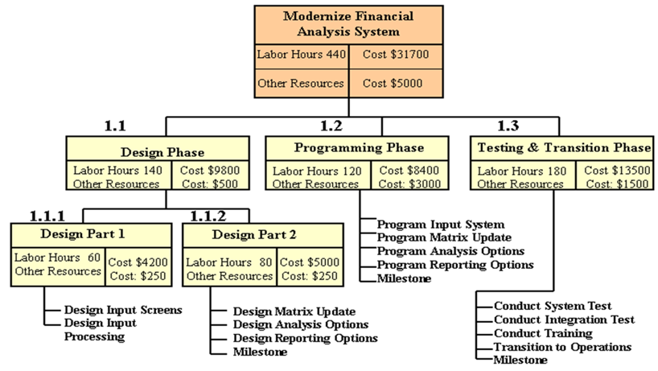
Example of WBS from Last Week Tutorial
Revise what you did last week. Then create a Gantt Chart

Slide 15
Homework (To be completed)
1. Read
Prince2 Guide – Section on Project Governance: (http://prince2.wiki/Processes)
Assessment 3 – Submissions.
Presentation Slides - Due on Friday, 9th October 2020 @ 11:59pm
Team’s Present in their Week 12 tutorials (12th – 16th October 2020)
Reading Material (DSDM Guide & Prince2 Guide) – are on blackboard

Slide 16
Close / Wrap Up
I look forward to your contributions next week
Thank you for your participation.
Notes:
16
16
16
16

